Slide 1
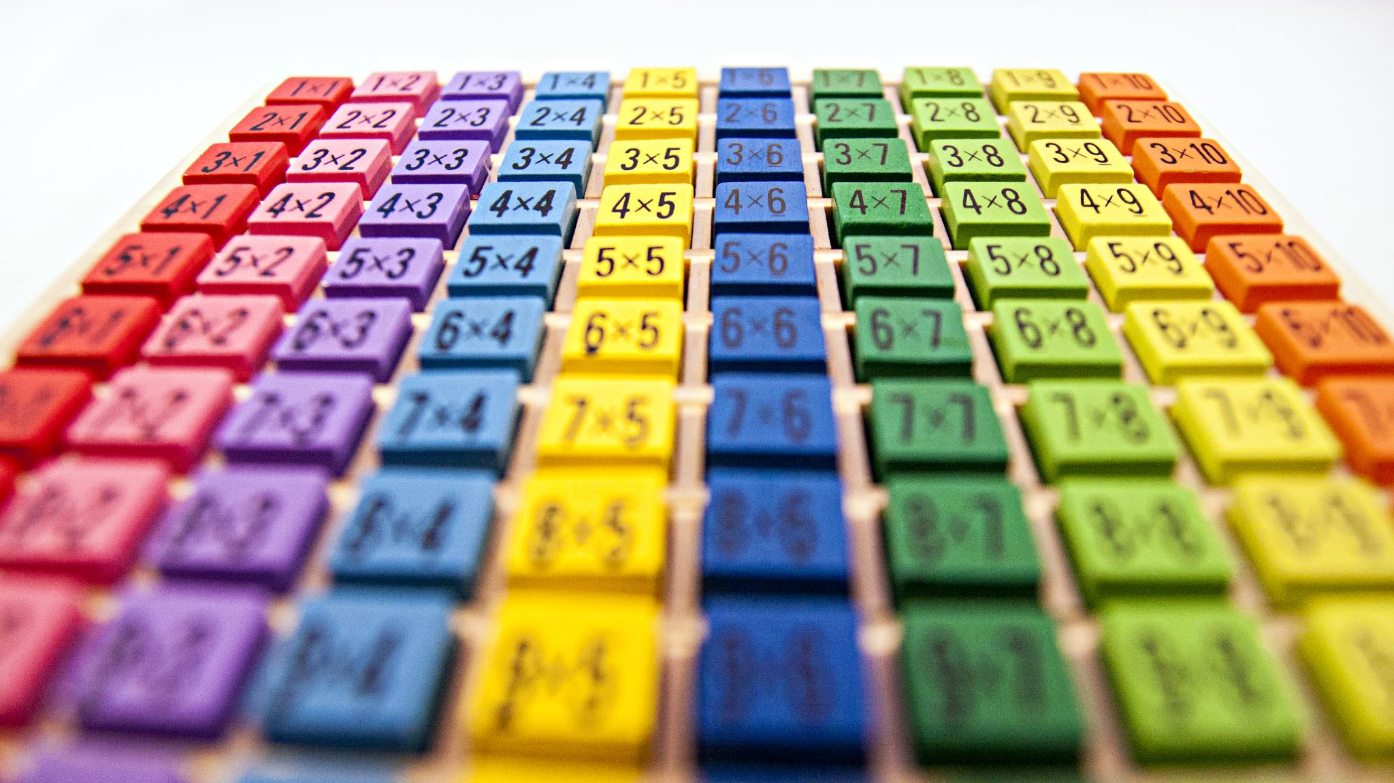
Arrays in C++
- Rishikesh Paudel

Slide 2
Objectives
All about arrays
Strings: an array of characters
All about pointers

Slide 3

What are Arrays and why do we need them?
Arrays:
An array is a data structure that stores a collection of elements, such as numbers, or strings, in a contiguous block of memory

Slide 4
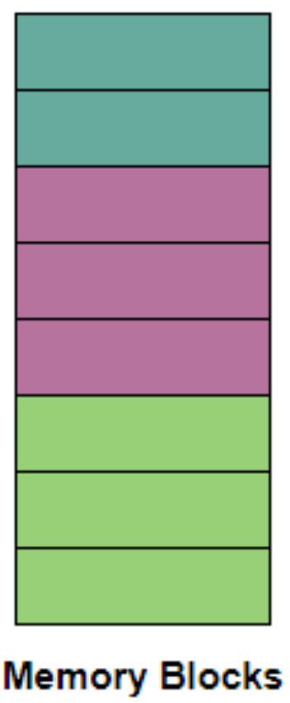
What is a contiguous block of memory?
Consecutive and Unbroken range of memory addresses within a computer's memory space

Slide 5
Defining and Printing an Array
#include <iostream>
using namespace std;
int main() {
// Defining an array
string cars[5] = {"Volvo", "BMW", "Ford", "Mazda", "Tesla"};
// Displaying Array
for (int i = 0; i < 5; i++) {
cout << cars[i] << "\n";
}
return 0;
}

Slide 6
Omitting Array Size in C++
string cars[] = {"Volvo", "BMW", "Ford"};
is equivalent to
string cars[3] = {"Volvo", "BMW", "Ford"};

Slide 7
Getting Array Size
Using sizeof() operator:
int myNumbers[5] = {10, 20, 30, 40, 50};
cout << sizeof(myNumbers);
sizeof() returns size in bytes

Slide 8
Getting Array Size
To display the actual length instead of memory space:
int myNumbers[5] = {10, 20, 30, 40, 50};
int getArrayLength = sizeof(myNumbers) / sizeof(int);
cout << getArrayLength;
This returns result 5

Slide 9

String: An array of letters?
char word[10] = {“w”, “o”, “r”, “d”};
char word[10] = “word”;

Slide 10
Multi-dimensional arrays:
An array of arrays

Slide 11
Declaration and Definition
Declaration:
string letters[2][4];
Declaration + Definition:
string letters[2][4] = {
{ "A", "B", "C", "D" },
{ "E", "F", "G", "H" }
};

Slide 12
C++ Structures
A way to group several related variables into one place.
Each variable in the structure is known as a member of the structure.

Slide 13
Creating a structure
Syntax:
struct myStruct{ // Structure declaration
int myNum; // Member (int variable)
string myString; // Member (string variable)
}; // Structure variable
int main()
{
myStruct myStruct1;
}

Slide 14
C++ References
A reference variable is a "reference" to an existing variable
It is created with the & operator
In short, it is a nickname of an existing variable

Slide 15
How to know the address of any variable?
using ‘&’ operator

Slide 16
Arrays and Pointers
Name of array is a pointer

Slide 17

What does it point to then?
The first item in the array list

Slide 18
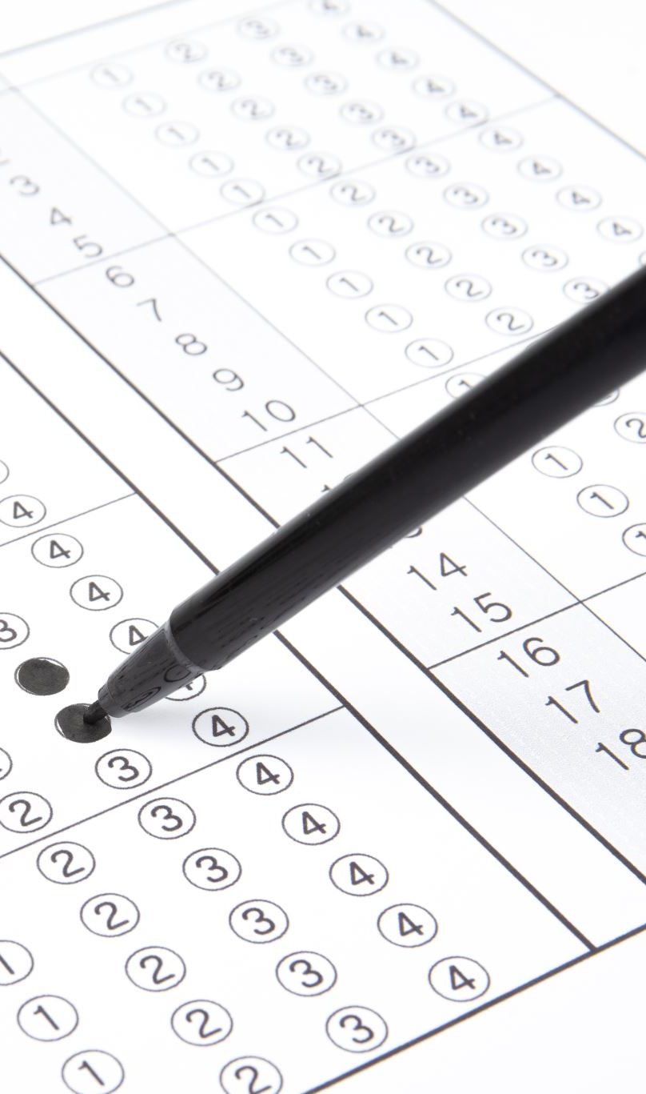
How to access the remaining items of array using pointer?
adding index number to pointer variable

Slide 19
What about 2D arrays?
See the example!

